Slide 1
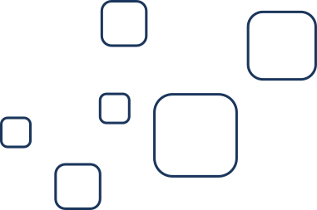
Mini Project
Machine Learning Classification

Slide 2


About Me
Marvin Nugraha
Student
Currently studying at Politeknik Negeri Jakarta,
3rd semester majoring in informatics engineering

Slide 3
I'm using The dataset from this link :
Dataset
https://scikit-learn.org/1.5/datasets/toy_dataset.html

Slide 4
Create a simple classification model to predict whether someone has diabetes or not based on the Diabetes dataset from scikit-learn.
I used Decision Tree Classifier Algorithm
Analytic Method

Slide 5
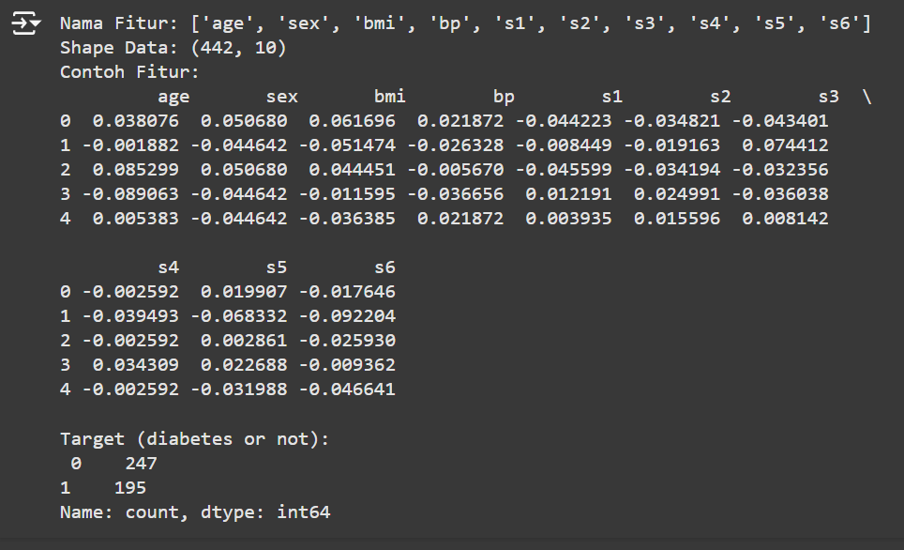
Load Dataset
The dataset contains information such as age, BMI, blood pressure, etc.
and there are 10 features with a binary classification target of 1 for diabetes and 0 for non-diabetes.

Slide 6
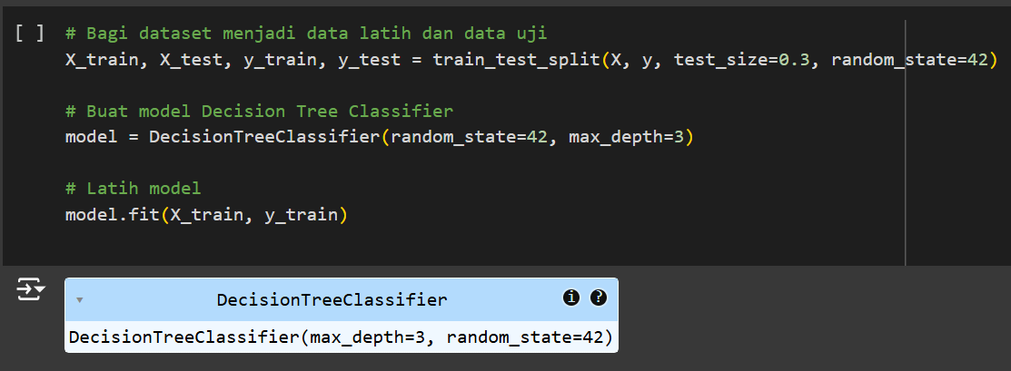
Training Model
Divide the dataset into 70% for training data and 30% for test data and the max depth is 3.

Slide 7
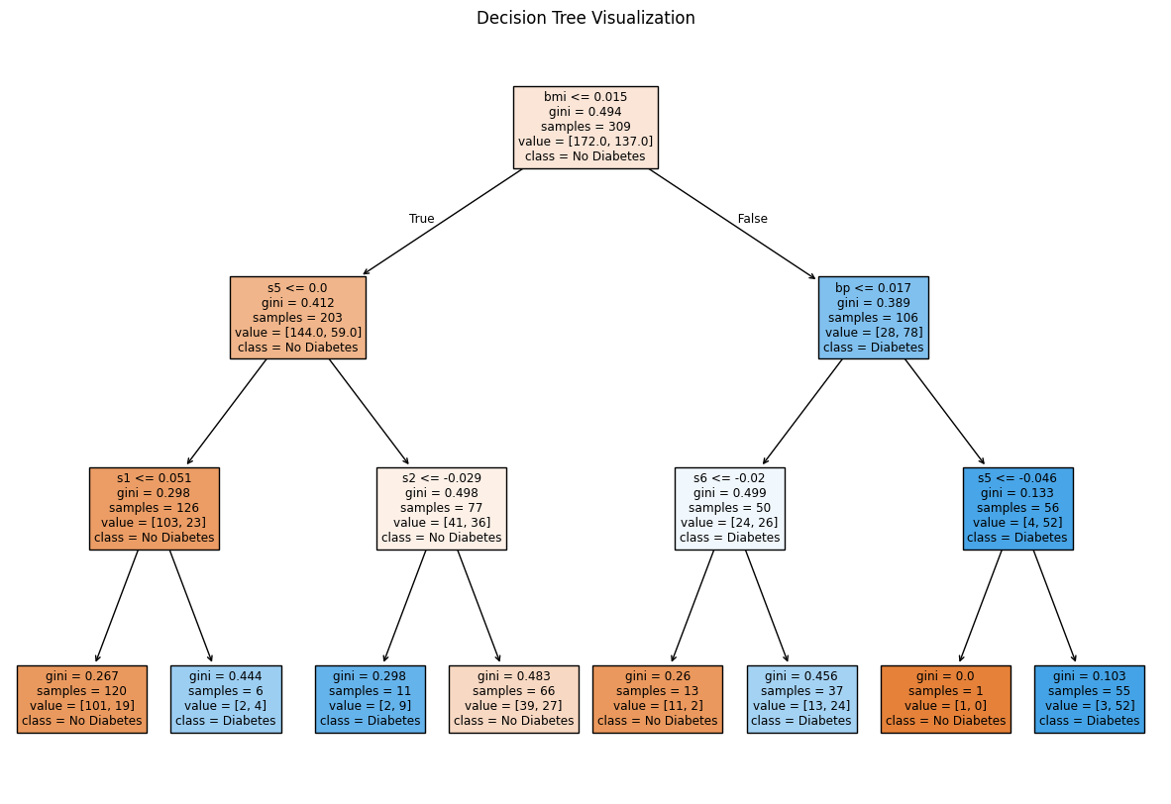

Visualization Decision Tree
The model was evaluated with the accuracy metric, reaching 72.18% on the test data. This result shows that the model is good enough but can still be improved.

Slide 8
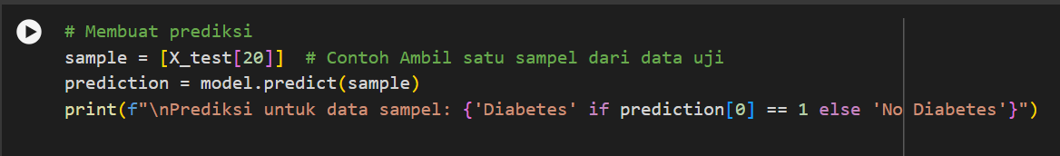

Prediction
Code
Output

Slide 9
Conclusion
The conclusion of this project is that the Decision Tree model successfully classifies diabetes data with an accuracy of 72.18%, which is quite a good performance for a simple model. The visualization of the decision tree makes it easy to understand how features affect the prediction. However, the model has limitations, such as accuracy that can be improved through parameter optimization, increasing the depth of the tree, or using a larger and more diverse dataset. This project provides a basic insight into the utilization of Decision Tree algorithm for medical classification that has the potential to be further developed.

Slide 10
Contact Details
Thank you
Linkedin:
https://www.linkedin.com/in/marvinugraha/
Github :
https://github.com/adenyuy
Email :
marvinugraha@gmail.com

